Slide 1
Smart pointer
https://docs.microsoft.com/en-us/cpp/cpp/smart-pointers-modern-cpp?view=vs-2019

Slide 2
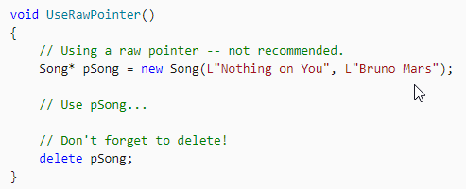
Using pointer to create object

Slide 3
Problem with pointers
We may forget to call delete (developers are still human afterall)
Object is created from another function, leads to confusion in ownership
Who should call destructor?
Or even worse, do we have the right to call the destructor?

Slide 4
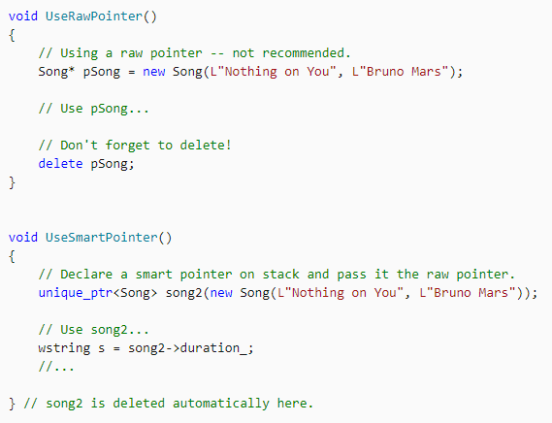
unique_ptr

Slide 5
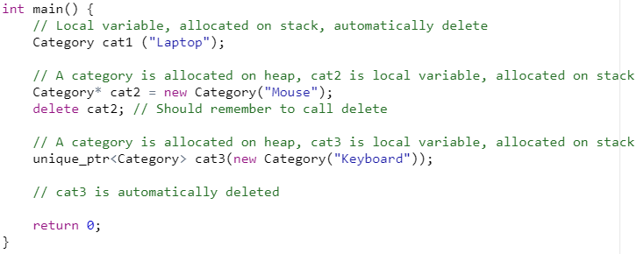
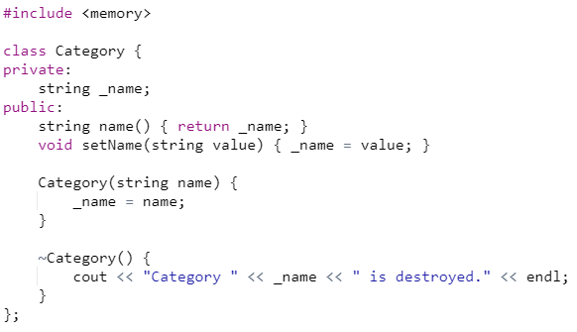

Creating a pointer to class Category

Slide 6


Access to methods & properties like normal pointer

Slide 7
Meaning of unique_ptr
Allows exactly one owner of the underlying pointer
If we want to have multiple owner, use shared_ptr
Reference-counted smart pointer

Slide 8
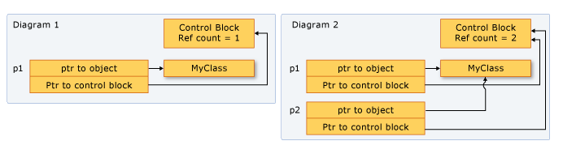
shared_ptr

Slide 9
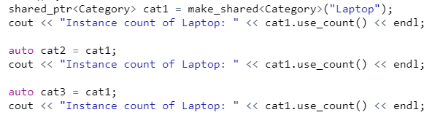

Creating shared pointer
When instance count reaches 0, the object is destroyed and its memory deallocated

Slide 10
Question
What if we just want to access the underlying object of a shared_ptr without causing the reference count to be incremented?
==> weak_ptr

Slide 11
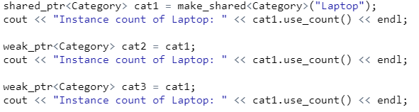

Creating weak_ptr

Slide 12
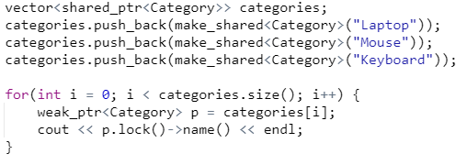
Using weak_ptr for iterating

